Slide 1
CS 3516 – Computer Networks
D Term, 2024
Instructor
Shubbhi Taneja, Ph.D.
Assistant Teaching Professor

Slide 2
Professor Background
Prof. Shubbhi Taneja, Ph.D.
Assistant Teaching Professor of CS
Background:
Auburn University
Doctor of Philosophy (Ph.D.): 2018
Pacific Northwest National Laboratory
Intern (2018) and collaborator: 2018 – Present
Sonoma State University
Assistant Professor: 2018 - 2021
Worcester Polytechnic Institute
Assistant Teaching Professor: 2021 – Present
Courses this year:
Computer Networks, Operating Systems, Application Building using OO Concepts, Systems and Network Programming

Slide 3
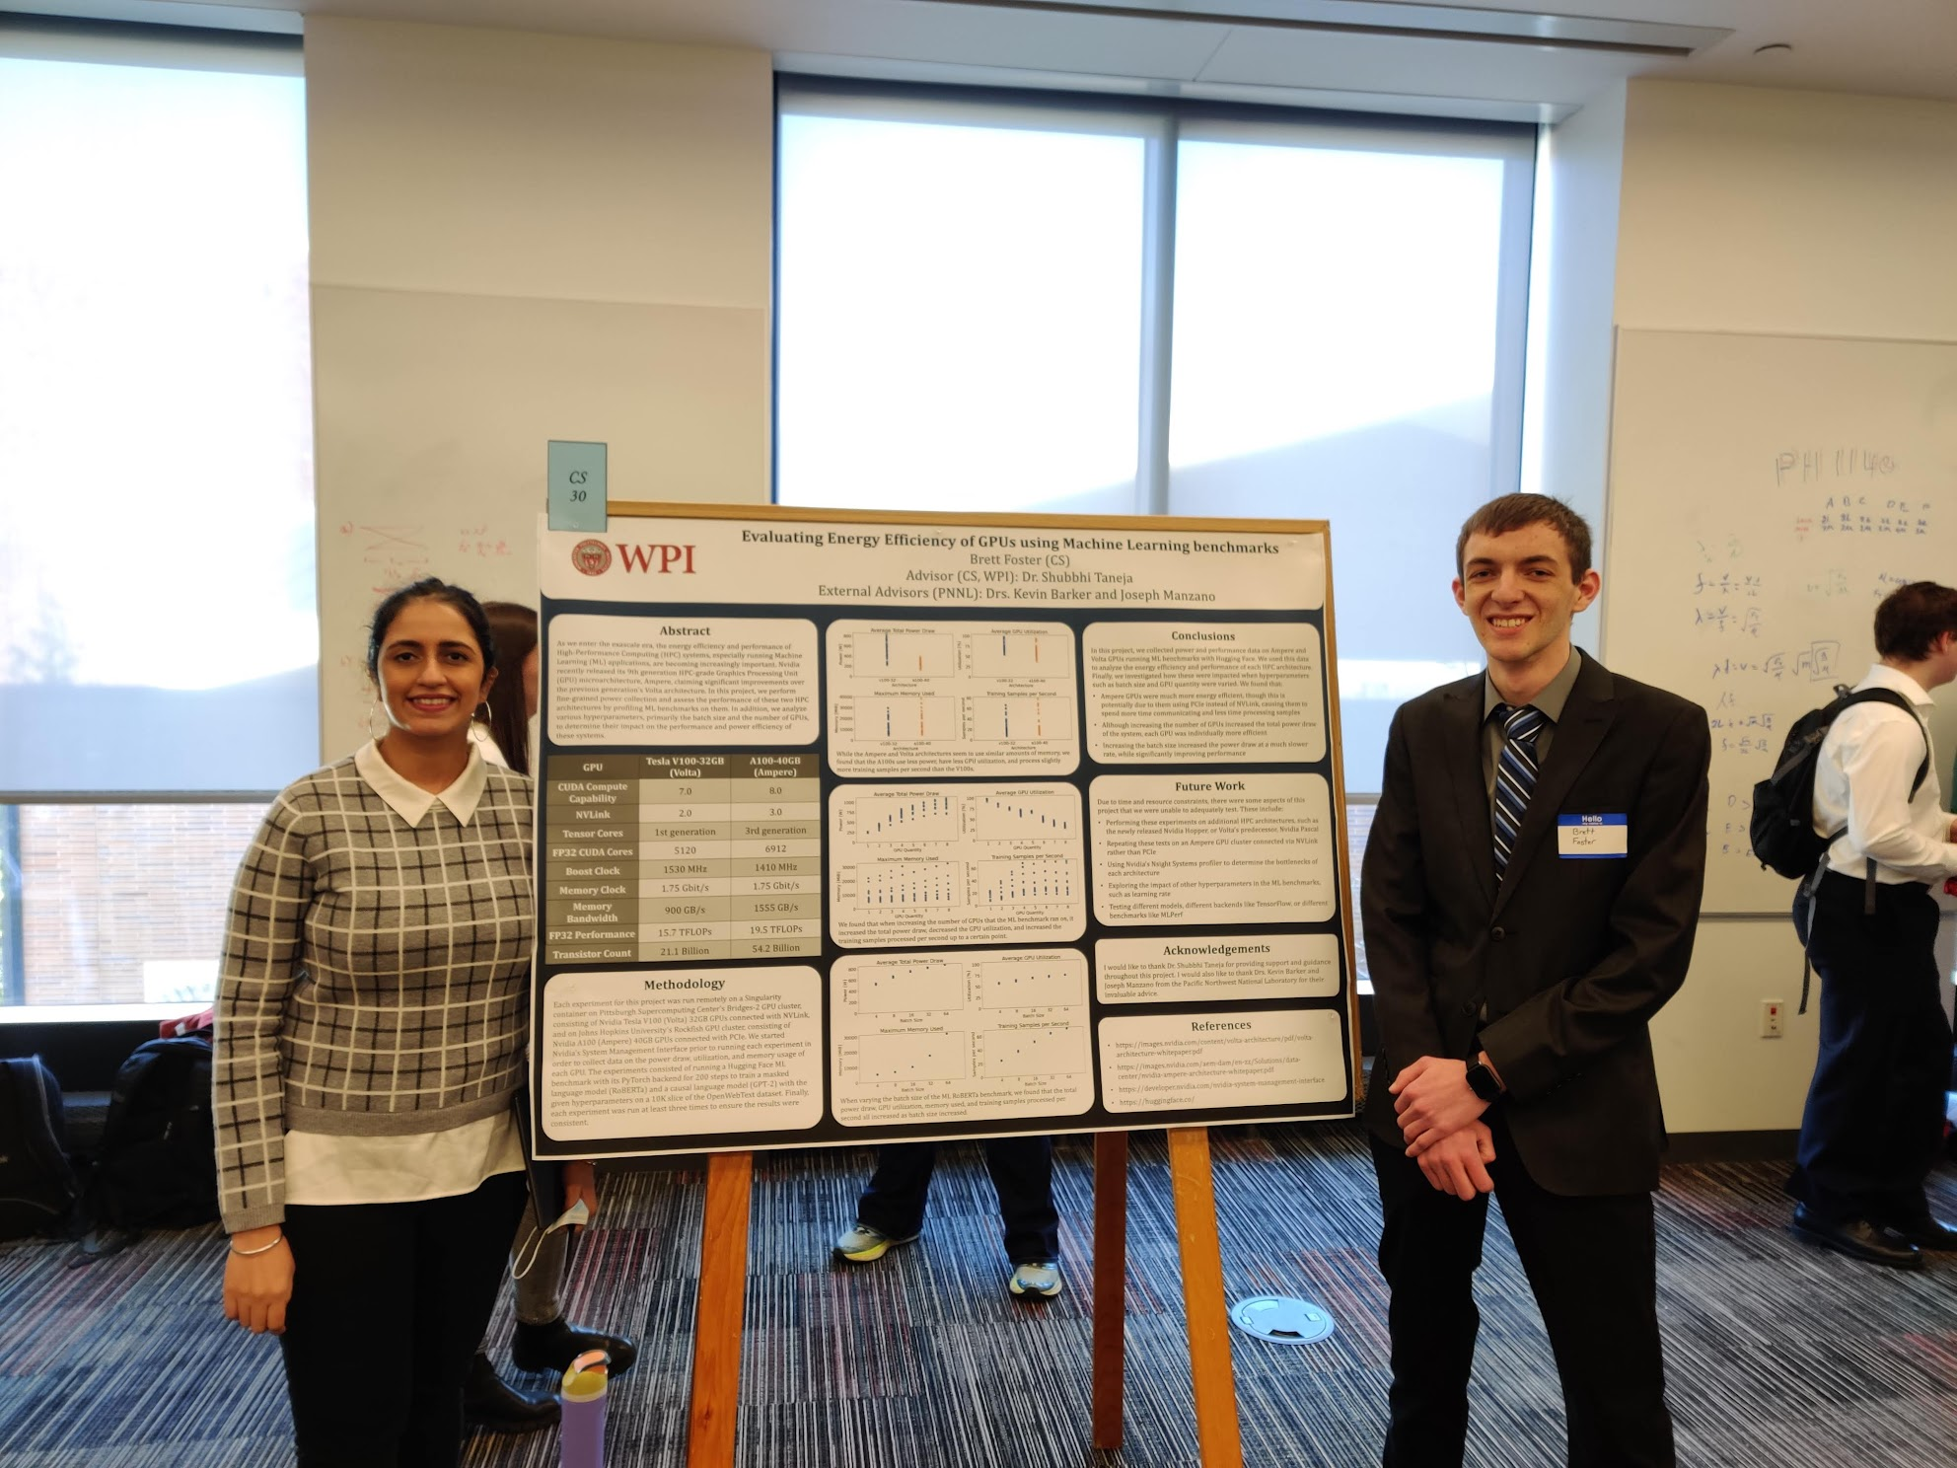
Some Research Activities
Evaluating Energy Efficiency of GPUs using Machine Learning Benchmarks
As we enter the exascale era, the energy efficiency and performance of High-Performance Computing (HPC) systems, especially running Machine Learning (ML) applications, are becoming increasingly important. Nvidia recently released its 9th-generation HPC-grade Graphics Processing Unit (GPU) microarchitecture, Ampere, claiming significant improvements over the previous generation’s Volta architecture. In this project, we perform fine-grained power collection and assess the performance of these two HPC architectures by profiling ML benchmarks on them. In addition, we analyze various hyperparameters, primarily the batch size and the number of GPUs, to determine their impact on the performance and power efficiency of these systems.

Slide 4
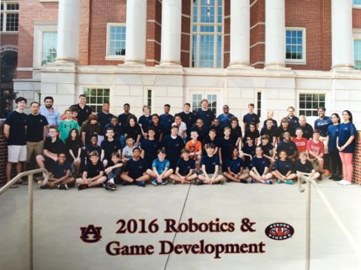
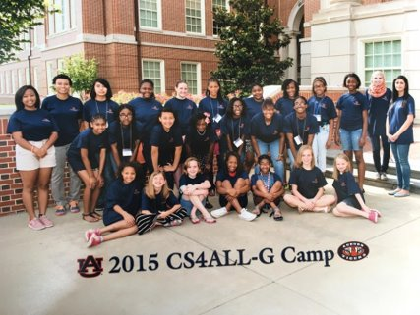
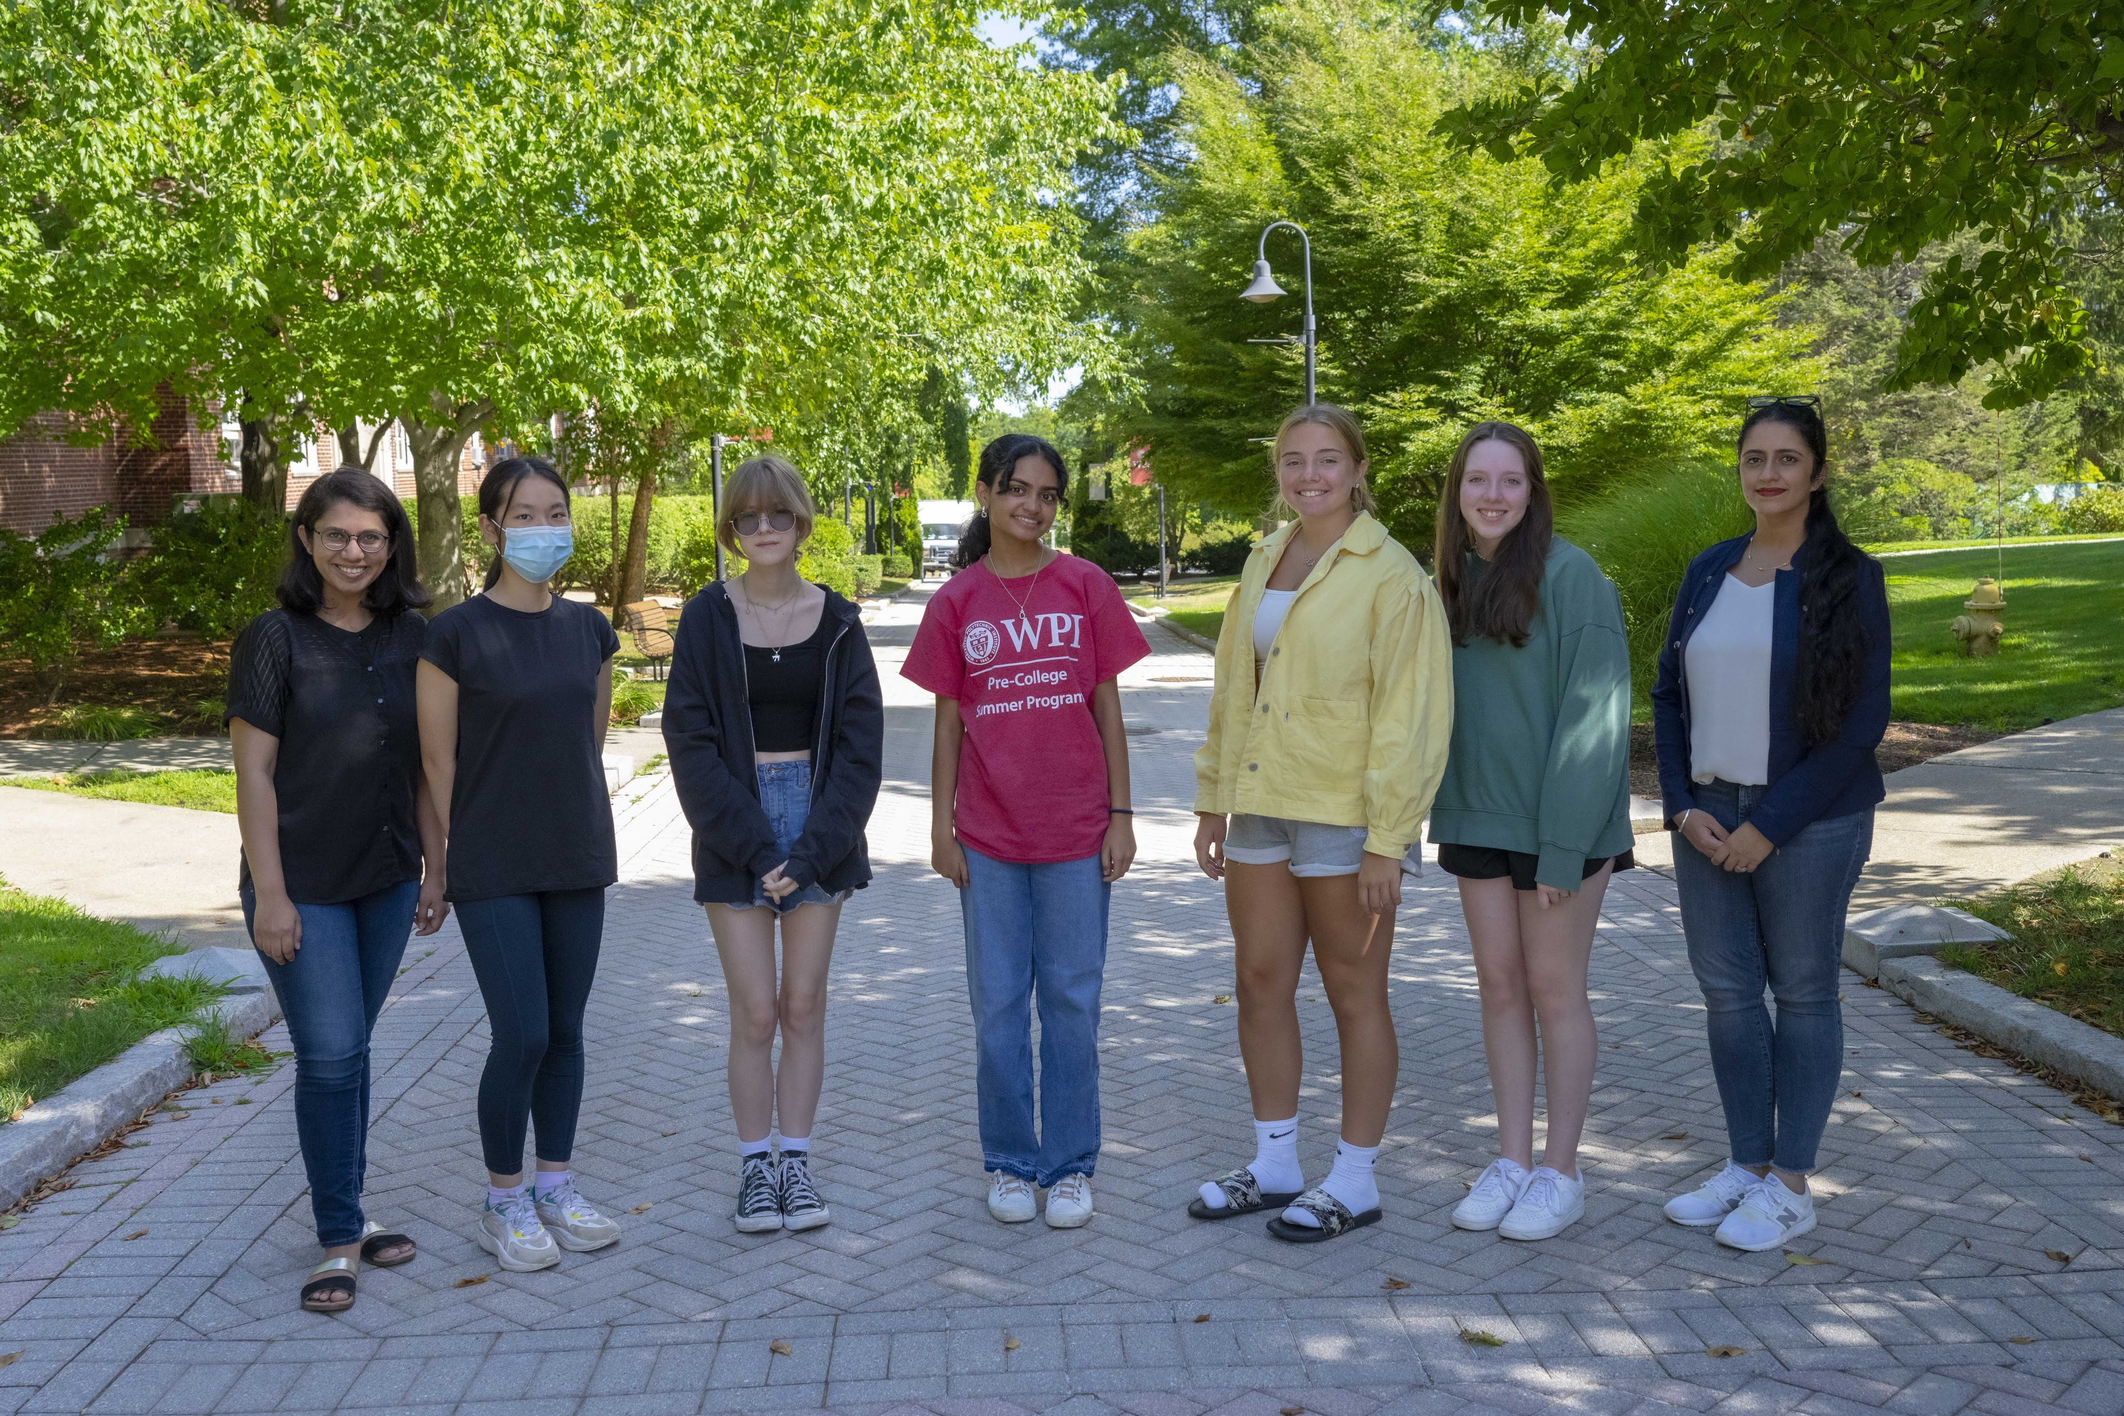
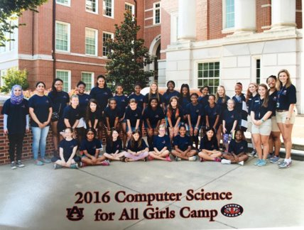
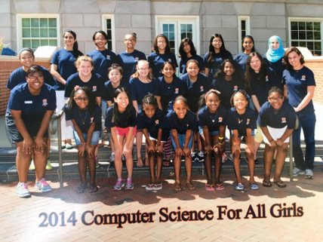
Some Outreach Activities

Slide 5
Teaching Style
Data-driven
Student feedback is critical

Slide 6
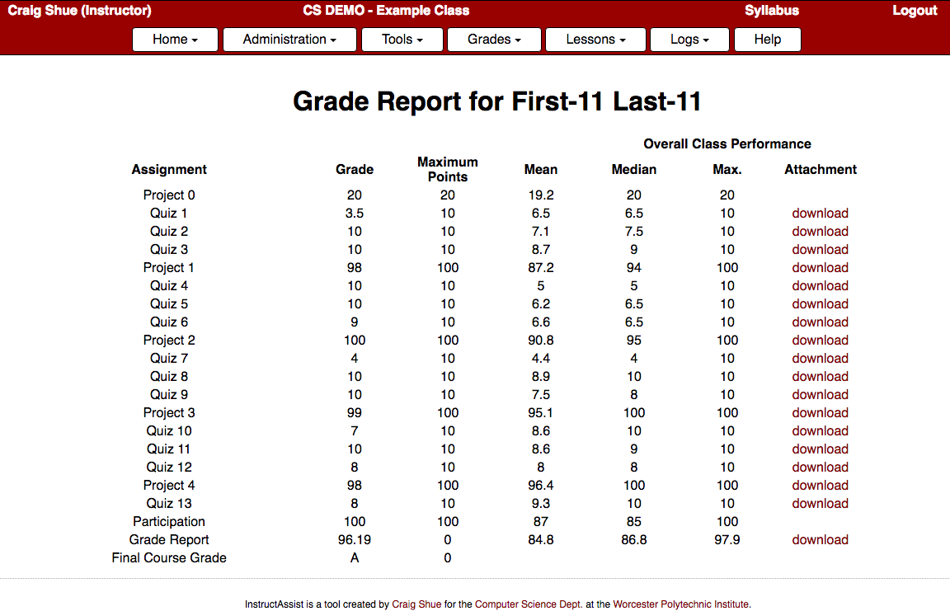
Grades
Automatically posted online via InstructAssist
https://ia.wpi.edu/cs3516/grades.php
Aiming for a 48 hour turn-around (faster if possible)

Slide 7
Teams
You can work in teams or by yourself
Teams of up to 2 people
https://ia.wpi.edu/cs3516/request_teammate.php
Option 1: Use WPI username to select teammate
Teammate gets an email; must click link to confirm
Option 2: Ask to be randomly assigned a partner
Option 3: Do nothing (work alone)
Partner evaluations after each project
Demonstrations required
Teams must be selected for each project

Slide 8
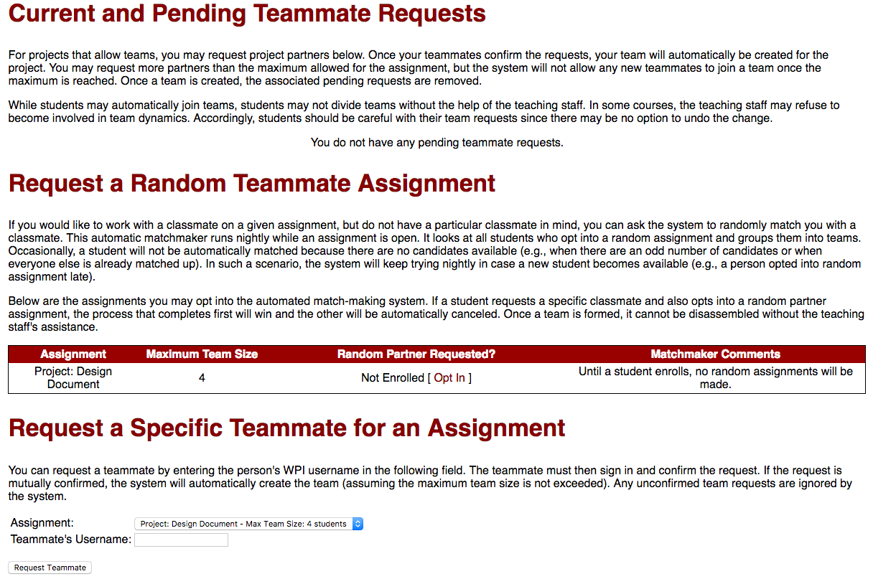
Requesting a Teammate

Slide 9
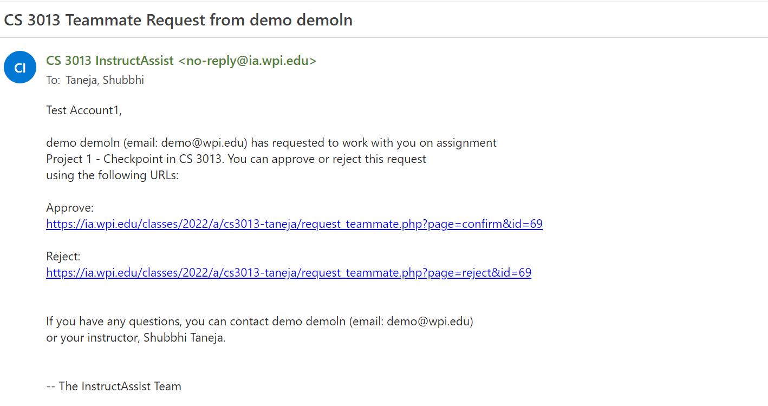
Requesting a Teammate – 2

Slide 10
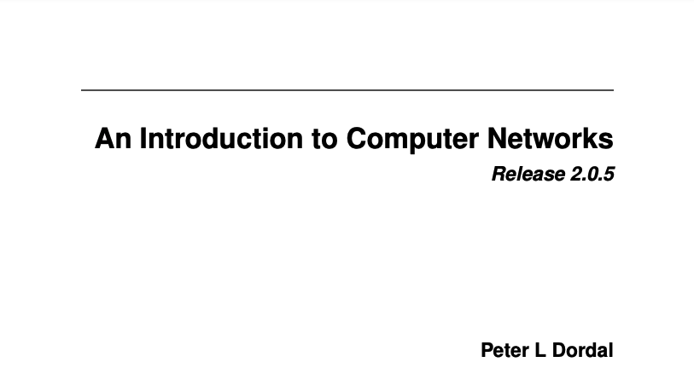
Syllabus
Online: http://web.cs.wpi.edu/~staneja/cs3516/
Academic misconduct
Most cases are misunderstandings. But, it is still unpleasant for everyone.
Textbook:
http://intronetworks.cs.luc.edu/current2/ComputerNetworks.pdf
10

Slide 11
Why learn about computer networks?
“The network is the computer”
Many applications are connected
Many devices are connected
You may know how to hook them up, but do you understand them?
A basic understanding of networking is fundamental with next-generation applications

Slide 12
Why are there two courses?
CS3516
Broad understanding of topics
Hands-on, but not as deep
CS4516
In-depth, more cutting-edge
Should appeal to many students

Slide 13
Course Objectives
Computer network architecture concepts
Broad view of network stack and protocols
Understanding of computer networks from a design and performance perspective
Expose standard network terminology
TCP/IP network socket programming
Introduce wireless and local area networks
Congestion and security topics

Slide 14
What You Need to Succeed
A solid C or C++ background
Historically, people without it do not succeed
Biggest cause of problems
A willingness to request help when needed
The teaching staff is here to help
Leverage each other (but do your own work)
The motivation to start early
These projects can’t be done (well) in a day

Slide 15
Syllabus Highlights
Grading
Labs, Projects, In-class quizzes, Participation
Programming in C/C++
Use of electronics
Academic misconduct
Most cases are misunderstandings.
It’s still unpleasant.

Slide 16

What is the internet?

Slide 17
Capital “I” vs. Lowercase “i”
An internet: Interconnection of multiple networks into one
The Internet: the world-wide network that replaced the ARPANET

Slide 18
What is the Internet?
Hosts or End Systems
Anything that has an address
Communication Links
Packet Switches
Routers (IP address forwarding)
Link Layer Switches (ethernet MAC addresses)
Transmission Rate
Packets
Routes and Paths
Wifi and sometimes ethernet on PC or laptops
ISPs (is WPI an ISP?)
Notes:
YES, WPI will be considered an ISP. Similarly, UMass, When you connect these smaller networks of WPI and Umass, we internetworked them.

Slide 19
What is the Internet? – 2
Protocols
Examples: TCP, IP
What is a protocol?
Format and order of messages and actions taken
Standards
Request for Comments
Distributed Applications
APIs for specifying how to transmit
Example: web browser communicating with web server
Notes:
A web browser generates many requests and only if the server is able to understand the requests, they will be served. The n/w communication turns into APIs for distributed systems

Slide 20
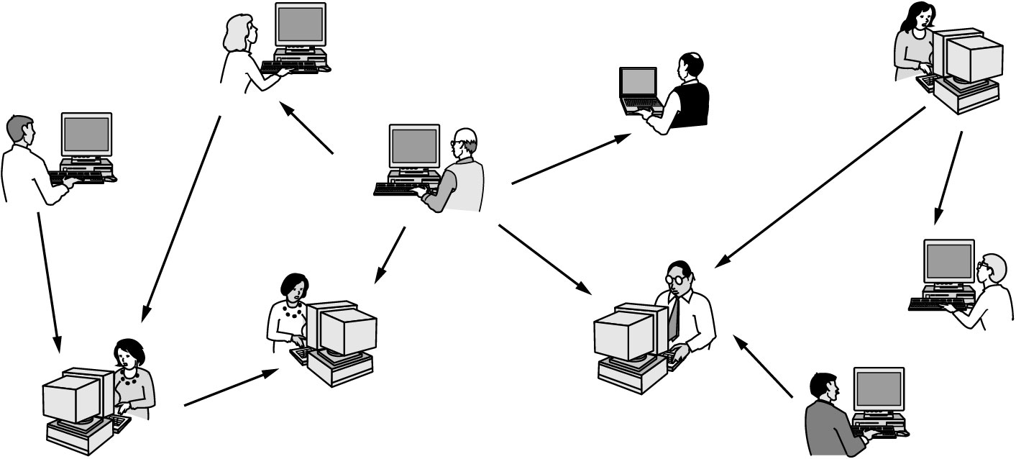
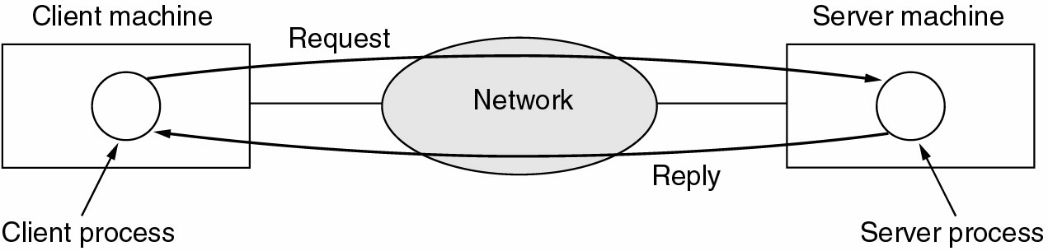
Living on the Network Edge
Devices/Types of Hosts
Clients and Servers (systems and programs)
Distributed applications (P2P, can act both as client & server)
Access networks
Telcos (transmit internet packets now)
Central Office
Telephony
(pr as tuh·leh·fuh·nee)
Notes:
Telephony – process of communication of the type described above
Telephony is technology associated with interactive communication between two or more physically distant parties via the electronic transmission of speech or other data. Long associated with voice communication, telephony has evolved to also include text messaging, video calling, video conferencing, voicemail, call recording and faxing.

Slide 21


Classifying by Transmission Technology
Broadcast
Logical or a physical concept
Multicast
Communication to a specified group.
This requires a group address (e.g. – multimedia multicast).
Unicast
Point-to-point
Specialized version of
Unicast; there is supposed to be
ONLY two entities present
Notes:
Multicast – Discord channel for example

Slide 22
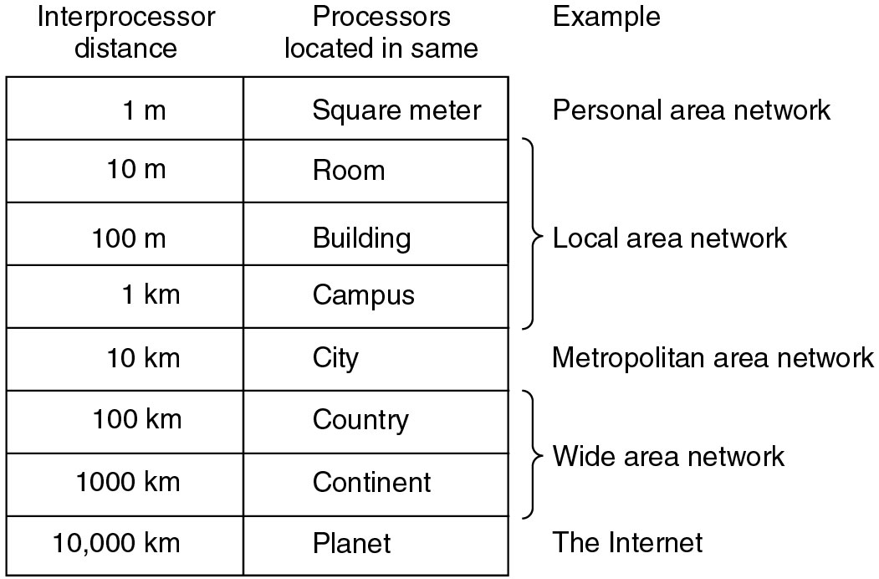
Classification by Size
(PAN)
(LAN)
(MAN)
(WAN)

Slide 23
Types of Access Network
Dial-up
DSL
One of the big two
About same market share as Cable in the US
Outside US, DSL over 90% in many countries
Twisted pair copper wire
Splitter separates voice and data
Asymmetric
Very-high speed DSL (VDSL)
Notes:
In US, cable modems are the most common ones
https://www.move.org/dsl-vs-cable-internet/

Slide 24
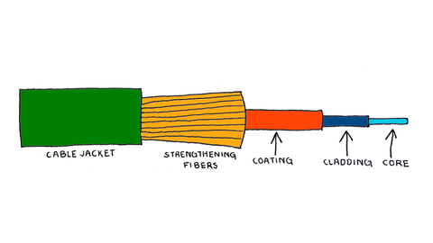
Types of Access Networks – 2
Cable Internet
Cable head end
Fiber optic cable between head ends
500 to 5,000 homes on a junction (fiber to the neighborhood)
Hybrid fiber coax (HFC)
Cable modems
Shared broadcast medium
Notes:
Modem without a router can let us receive data of our neighbors

Slide 25
Types of Access Networks – 3
Fiber to the home/premises
Direct fiber
Active optical networks
Passive optical networks
WiFi
Wide-Area Wireless Networks
WiMaX
LTE
5G

Slide 26
Wireless != Mobile
Wireless involves transmissions through the air (type depends on frequency).
Residential access networks
Residential access points
Institutional access networks
Institutional and corporate access points or mesh networks
Public access networks
e.g., Cities, towns, libraries and coffee shops
Cellular networks
2.5G, 3G and 4G

Slide 27
Wireless != Mobile – 2
Mobile can refer to the Hosts.
Laptops can be moveable and wired.
Laptops can be moveable and wireless.
Cell phones, smart phones, PDAs and devices in vehicles are mobile and wireless.
Mobile Ad Hoc NETworks (MANETs)
wireless devices are both hosts and subnet nodes (routers).
The distinction is that MANET nodes may relay traffic intended for other nodes (multi-hop traffic).

Slide 28
Physical Media
Guided
DSL, Cable, Fiber
Unguided
Wireless, Satellite
Twisted-Pair Copper Wire
Cheap
Unshielded Twisted Pair (UTP) used within buildings
Coaxial Cable
Copper, but concentric (to shield the communication)
Fiber Optics
Great for long haul (attenuation, tapping, interference)
Expensive parts make short-haul costly
51.8Mbps to 39.8Gbps

Slide 29
A Brief History of the Internet
Packet Switching (1961-1972)
Proprietary Networks and Internetworking (1972–1980)
Proliferation of Networks (1980-1990)
Internet Explosion (1990s)
Recent Time

Slide 30
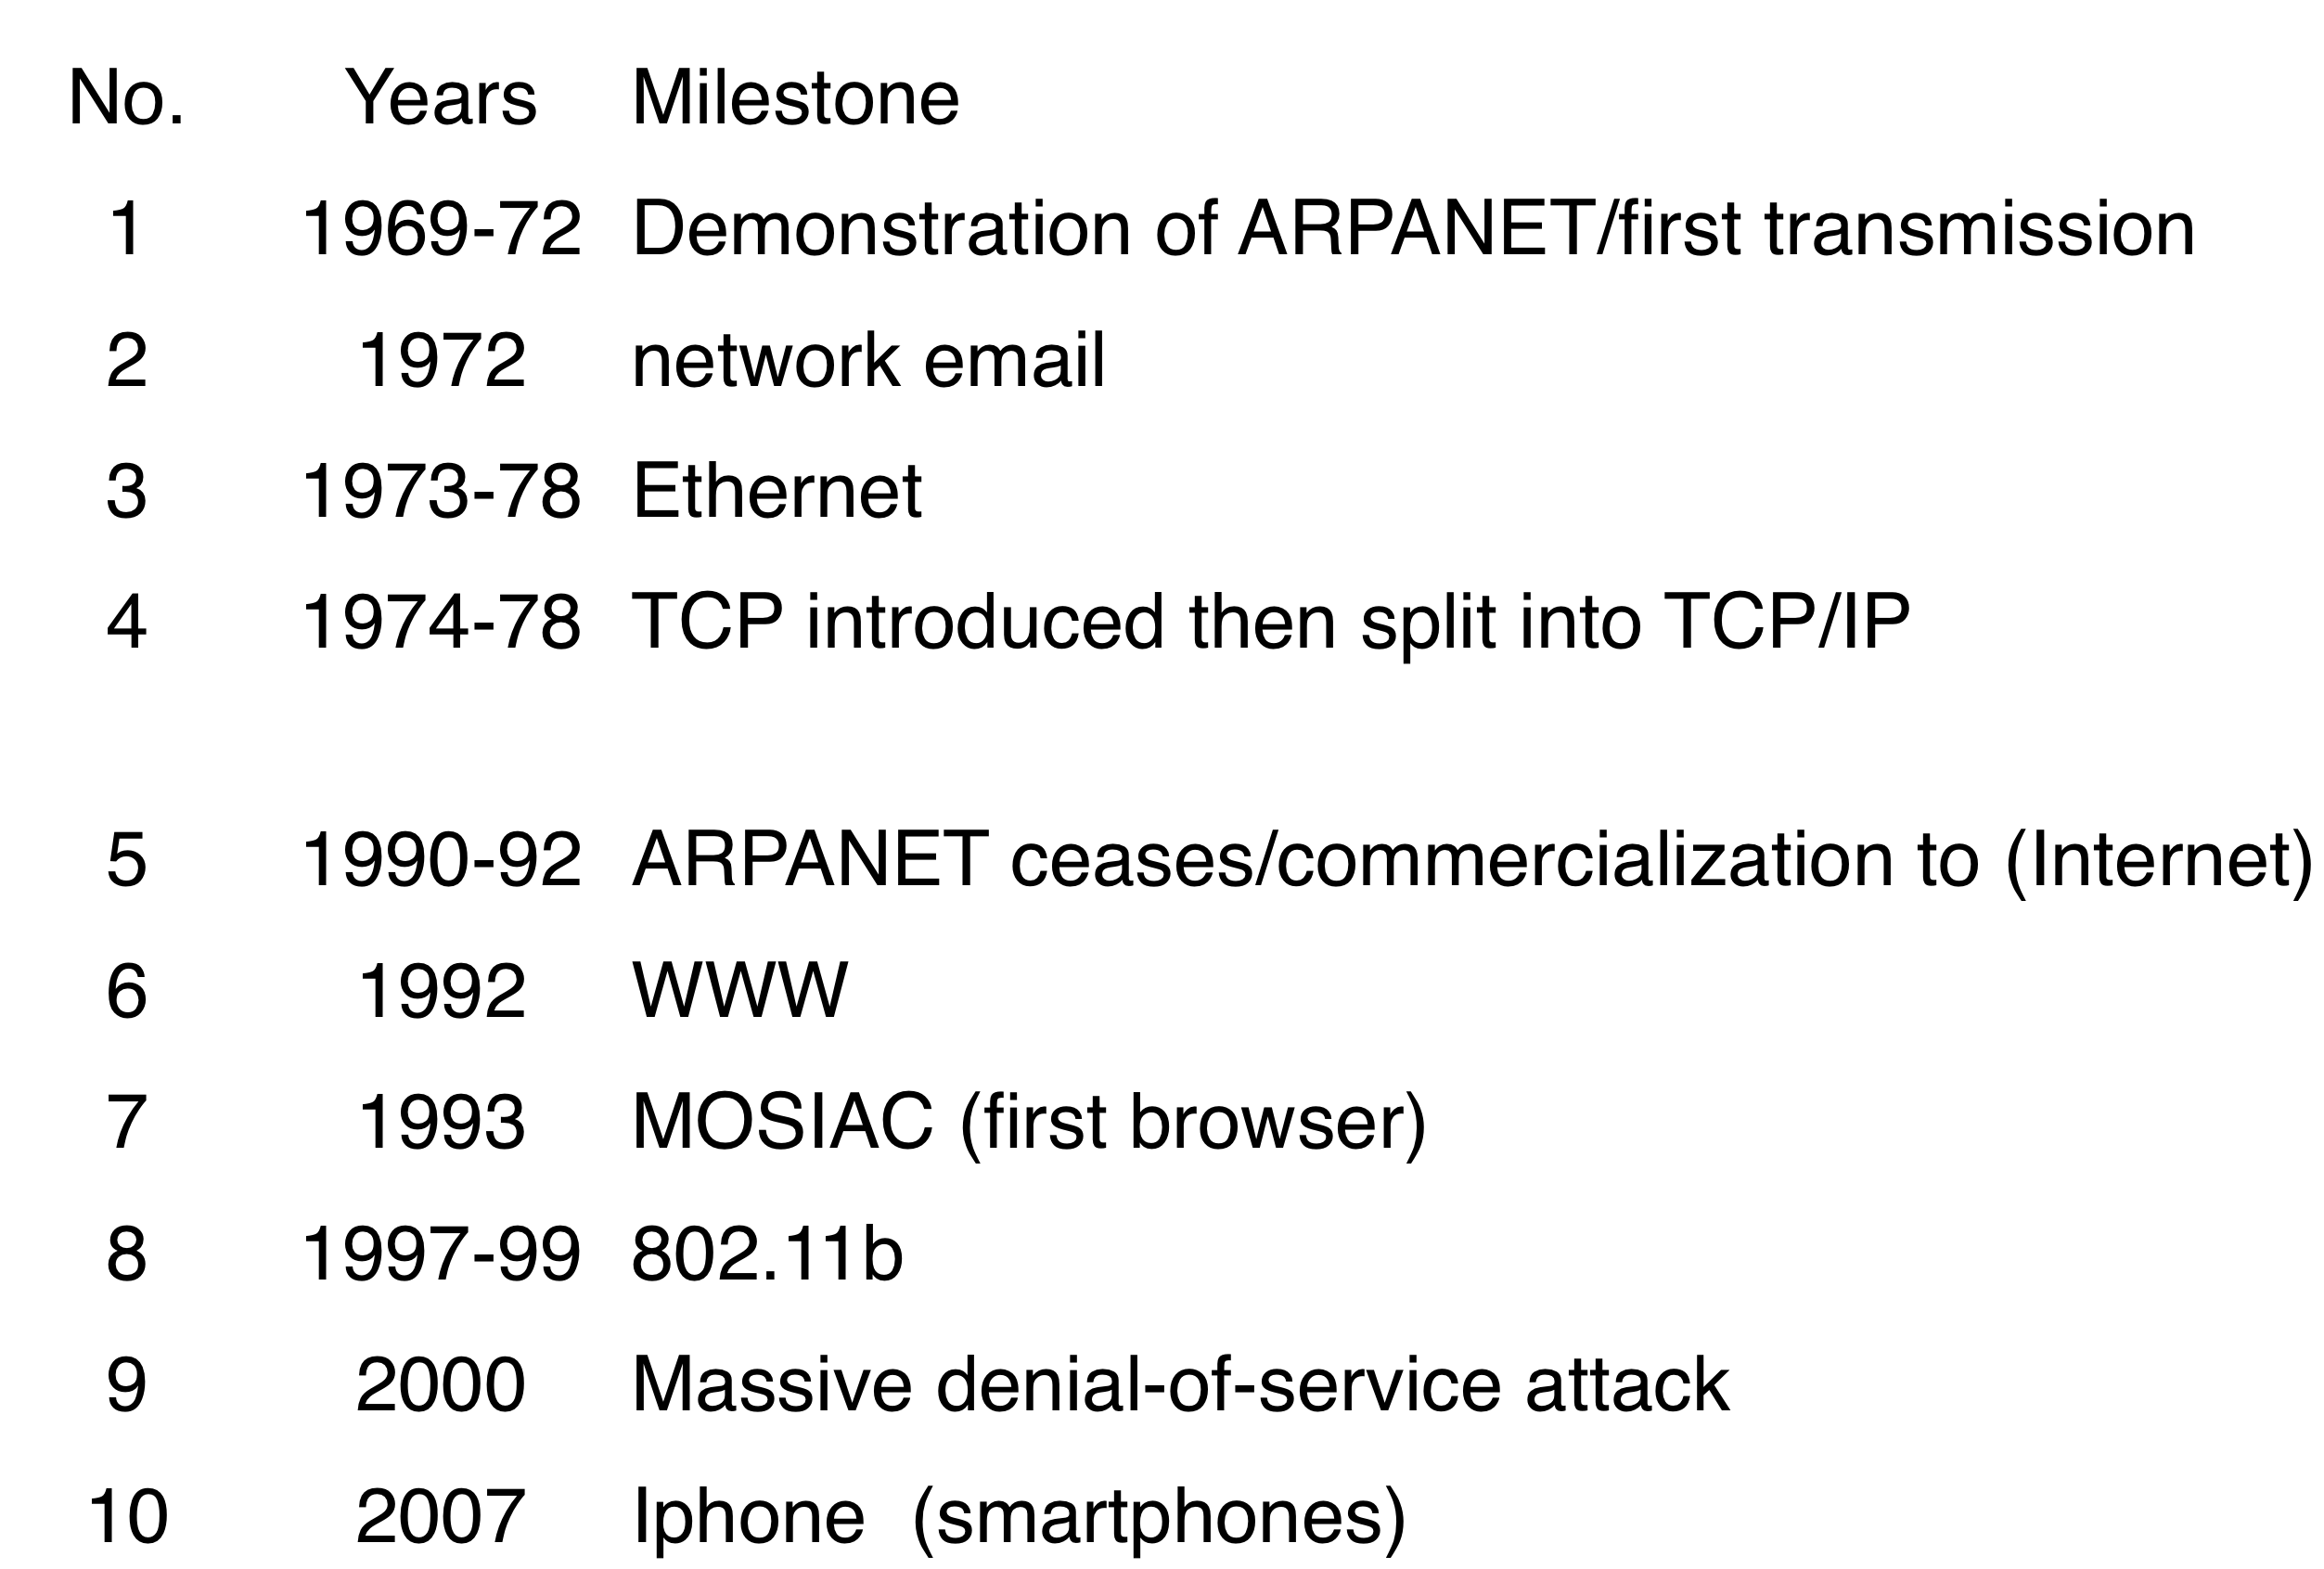
Quick Milestones

